Slide 1

Statistical Computation Methods for Data Science
Unit I, Lecture 3
By
S U Ravi Kumar Ch
Assistant professor of Mathematics
Department of Science and Humanities
Sreenidhi Institute of Science and Technology
Yamnampet, Ghatkesar.
1
Notes:
1

Slide 2
We discuss the following in today’s Lecture
Types of Data
Measures of Central Tendency
Mean
Median
Mode

Slide 3
MEDIAN
If a set of observations are arranged in ascending or descending order, then the middle most gives the median.
Note: Median is also called as average of position

Slide 4
Note:
If n is odd then [(n+1)/2]^{th} term is median.
If n is even, then median is the average of (n/2)^{th} term and [(n/2)+1]^{th} term.

Slide 5
Example 1
Find the Median of 4, 12, 7, 9, 14, 17, 16
Solution:
Arranging the given data in the ascending order, we obtain
4, 7, 9, 12, 14, 16, 17
The middle most value is 12
Then Median =12

Slide 6
Example 2
Find the median of 4, 12, 7, 9, 14, 17, 16, 21
Solution:
Arranging the given data in ascending order, we obtain
4, 7, 9, 12, 14, 16, 17, 21
Median is the average of two middle most values.
Median = (12+14)/2 = 13

Slide 7
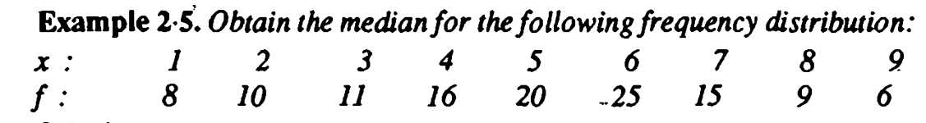
Example 3

Slide 8
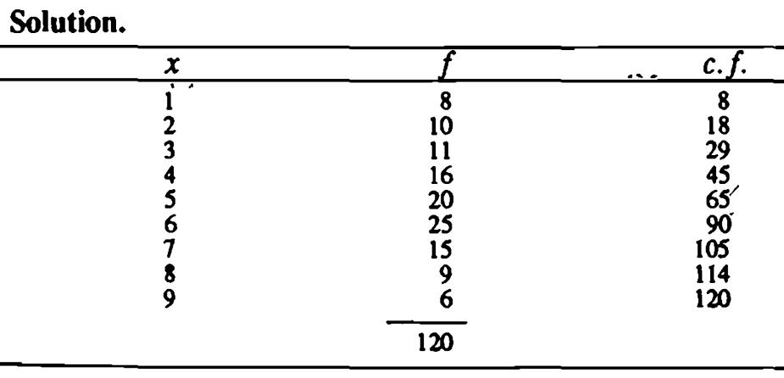
Example 3

Slide 9
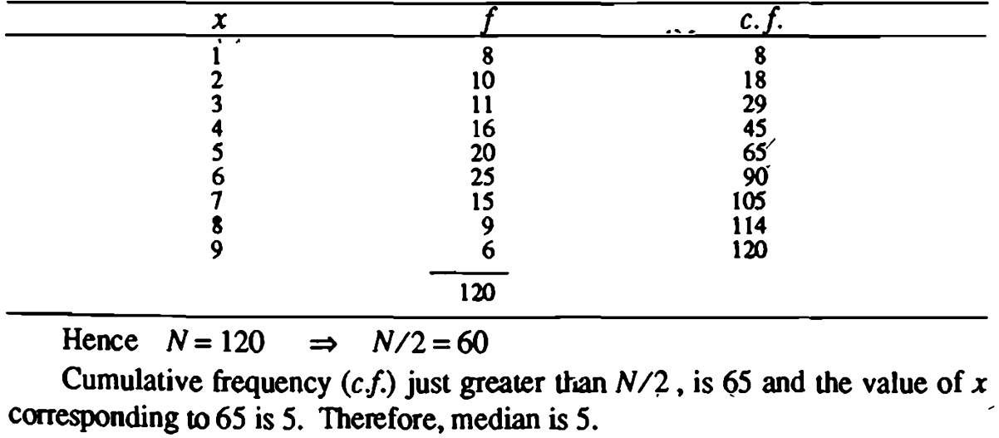
Example 3

Slide 10
For the Grouped data (continuous frequency),
Note: The class corresponding to the C.F. just greater than N/2 is called the Median class.

Slide 11
l is lower limit for (ideal) median class
f is frequency of median class.
m is cumulative frequency of the class preceding to the median class.
c is length of class interval

Slide 12
Example 1
Find the median for the following data:
Class Interval | 15-25 | 25-35 | 35-45 | 45-55 | 55-65 | 65-75
Frequency | 4 | 11 | 19 | 14 | 0 | 2

Slide 13
Solution:
Class Interval | Frequency | Cumulative Frequency
15 - 25 | 4 | 4
25 - 35 | 11 | 15(m)
35 - 45 | 19 (f) | 34
45 - 55 | 14 | 48
55 - 65 | 0 | 48
65 - 75 | 2 | 50

Slide 14
Total Frequency, N=50
Then N/2 = 25, here 25 lies above 15 and below 34.
Hence Median class is: 35 – 45.
Then f = 19, m = 15, l = 35 and c = 10

Slide 16
Example 2
Find the median wage of the following distribution:
Wages(in Rs.) | 20-30 | 30-40 | 40-50 | 50-60 | 60-70
No. of laborers | 3 | 5 | 20 | 10 | 5

Slide 17
Solution:
Class Interval | Frequency | Cumulative Frequency
20 – 30 | 3 | 3
30 – 40 | 5 | 8(m)
40 – 50 | 20 (f) | 28
50 – 60 | 10 | 38
60 - 70 | 5 | 43

Slide 18
Total Frequency, N=43
Here N/2 = 21.5, Cumulative frequency just greater than 21.5 is 28 and corresponding class is 40 – 50.
Then f = 20, m = 8, l = 40 and c = 10

Slide 20
Merits and Demerits of Median
Merits:
It is rigidly defined
It is easily understood and is easy to
calculate. In some cases it can be located
merely by inspection.
It is not at all affected by extreme values.
It can be calculated for distributions with
open-end classes.

Slide 21
Merits and Demerits of Median
Demerits:
In case of even number of observations
median cannot be determined exactly.
It is not based on all the observations.
It is not amenable to algebraic treatment.
As compared with mean, it is affected
much by fluctuations of sampling.

Slide 22
Uses of Median
Median is the only average to be used while dealing with qualitative data which cannot be measured quantitatively but still can be arranged in ascending or descending order of magnitude.
It is to be used for determining the typical value in problems concerning wages, distribution of wealth, etc.

Slide 23
MODE
Mode is the value of the variable which occurs most frequently.
i.e. it represents the most frequent value of the series.

Slide 24
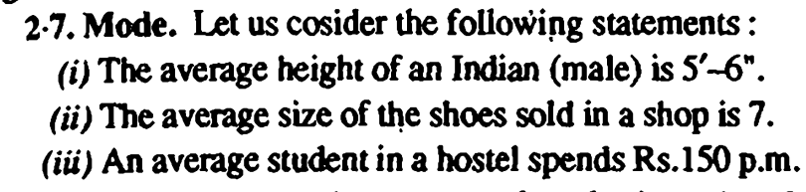
In all the above cases, the average referred to is mode.
Mode is the value which occurs most frequently in a set of observations and around which the other items of the set cluster densely.

Slide 25
Examples
1. 10, 11, 12, 14, 17, 24, 27, 24
Mode=24 (Unimodal)
2. 14, 17, 14, 20, 24, 20
Mode=14, 20 (Bimodal)

Slide 26
For Grouped data:
Note: The class with maximum frequency is called Modal class.

Slide 27
where l is lower limit of modal class
Δ₁ = f_{m} – f_{m-1} , Δ₂ = f_{m} – f_{m+1}
Here f_{m} → frequency of modal class
f_{m-1}→ frequency of class preceding the modal class
f_{m+1}→ frequency of class succeeding the modal class
c → size of class interval

Slide 28
Example 1:
Calculate the mode for the following frequency data
Class Interval | 10-20 | 20-30 | 30-40 | 40-50 | 50-60 | 60-70
Frequency | 5 | 8 | 12 | 16 | 10 | 8

Slide 29
C.I. | Frequency
10-20 | 5
20-30 | 8
30-40 | 12(f_{m-1})
40-50 | 16(f_{m)}
50-60 | 10(f_{m+1})
60-70 | 8
Solution:

Slide 30
From the table Modal class is 40-50
Then, c=10, l = 40
f_{m} = 16, f_{m-1}=12, f_{m+1}=10
Δ₁ = f_{m} – f_{m-1} =4, Δ₂ = f_{m} – f_{m+1}=6

Slide 31
Example 2:
Find the mode for the following distribution:
Class Interval | 0-10 | 10-20 | 20-30 | 30-40 | 40-50 | 50-60 | 60-70 | 70-80
Frequency | 5 | 8 | 7 | 12 | 28 | 20 | 10 | 10

Slide 32
Solution:
Here the maximum frequency is
28, thus the class 40-50 is modal
Class. Using the below formula
C.I. | Frequency
0-10 | 5
10-20 | 8
20-30 | 7
30-40 | 12(f_{m-1})
40-50 | 28(f_{m})
50-60 | 20(f_{m+1})
60-70 | 10
70-80 | 10

Slide 33
From the table Modal class is 40-50
Then, c =10, l = 40
f_{m} = 28, f_{m-1}=12, f_{m+1}=20
Δ₁ = f_{m} – f_{m-1} =16, Δ₂ = f_{m} – f_{m+1}= 8

Slide 34
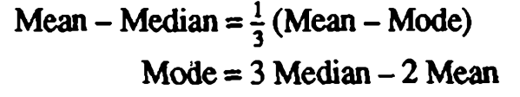

Sometimes mode is estimated from the mean and median by using the following formula:

Slide 35

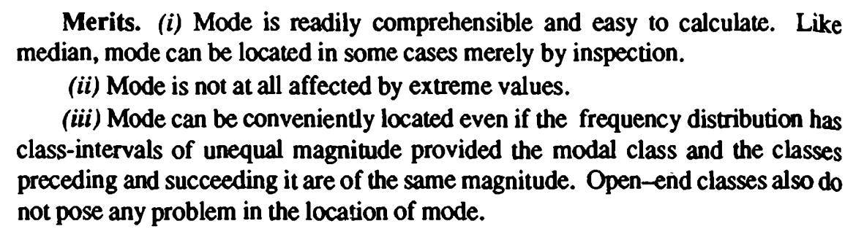

Slide 36
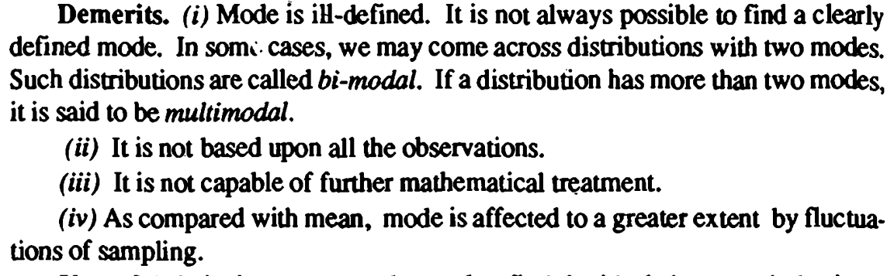

Slide 38
Recapitulation:
Types of Data
Ungrouped
Grouped
Measures of Central Tendency
Mean
Median
Mode

Slide 39
THANK YOU
Feed Back to:
ravikumarch@sreenidhi.edu.in
Notes:
39

